Slide 1
Conditioning on a_t

Slide 2
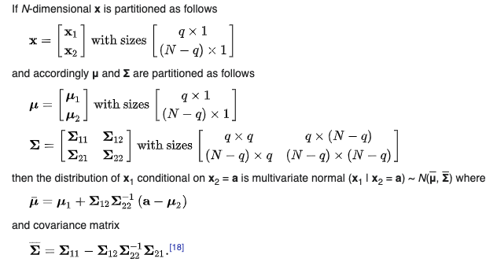
Review Conditional Gaussian;
Wikipedia;
*derivation using partitioned matrices in Ch 13.3 of Micheal Jordan’s CS281 text

Slide 3
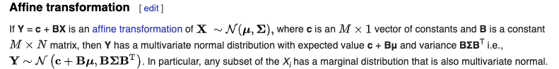
Other fact; Affine transforms of Gaussians are also Gaussians

Slide 4
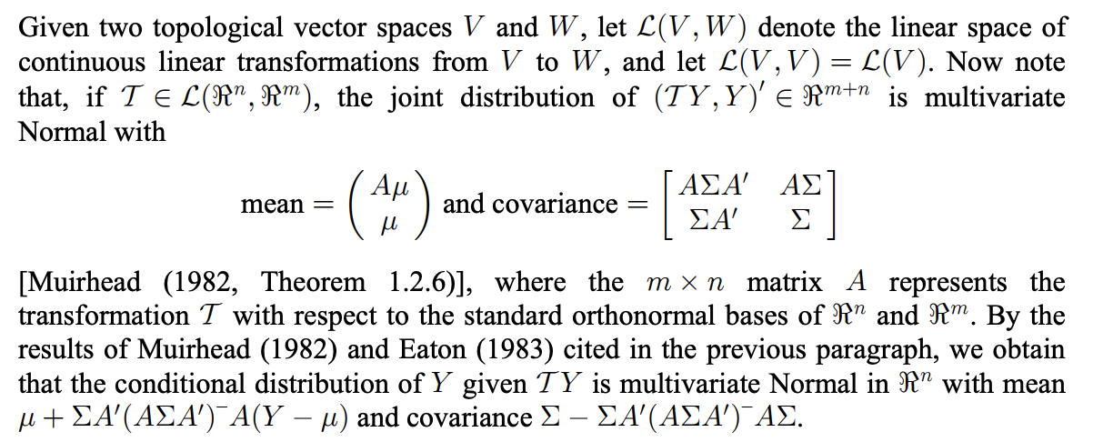
So we can make a joint distribution of y_t and a_t:
Interesting aside; Conditioning with non-affine transforms; https://arxiv.org/pdf/1710.09285.pdf
For us, let A = K (kalman gain via decoder)

Slide 5

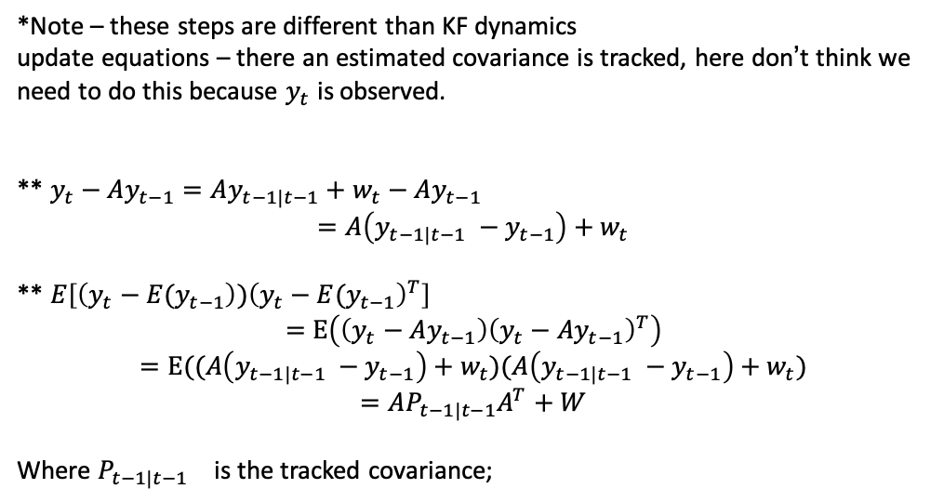
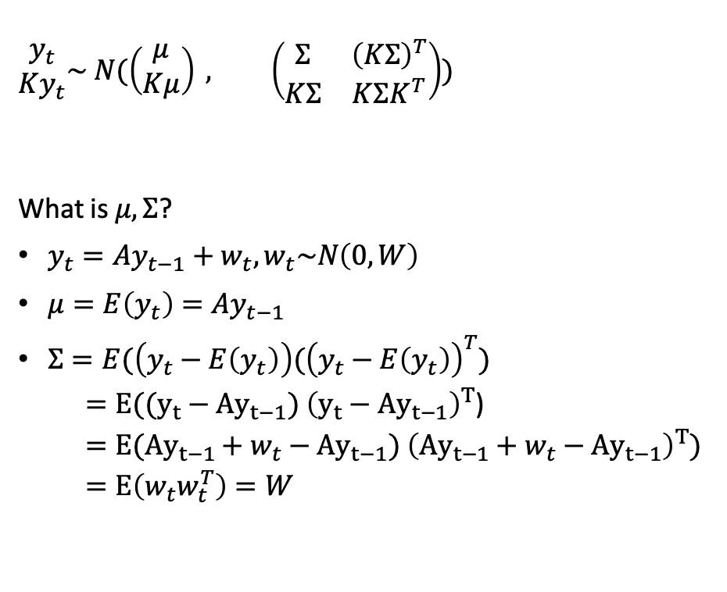
So, we can write;
$$\begin{matrix}y_{t} \\ Ky_{t}\end{matrix}\sim N(\left(\begin{matrix}μ \\ Kμ\end{matrix}\right) , \left(\begin{matrix}Σ & {\left(KΣ\right)}^{T} \\ KΣ & KΣK^{T}\end{matrix}\right))$$
What is $μ, Σ$?
$y_{t}=Ay_{t−1}+w_{t}, w_{t}\sim N\left(0, W\right)$
$μ=E\left(y_{t}\right)=Ay_{t−1}$
$Σ=E(\left(y_{t}−E\left(y_{t}\right)\right)({\left(y_{t}−E\left(y_{t}\right)\right)}^{T})$
$=E((y_{t}−{Ay}_{t−1})$ ${\left(y_{t}−{Ay}_{t−1}\right)}^{T}$)
$=E({Ay}_{t−1}+w_{t}−{Ay}_{t−1})$ ${\left({Ay}_{t−1}+w_{t}−{Ay}_{t−1}\right)}^{T})$
$=E\left(w_{t}w_{t}^{T}\right)=W$
*Note – these steps are different than KF dynamics
update equations – there an estimated covariance is tracked, here don’t think we need to do this because $y_{t}$ is observed.
** $y_{t}−Ay_{t−1}=Ay_{t−1|t−1}+w_{t}−Ay_{t−1}$
$$=A\left(y_{t−1|t−1} −y_{t−1}\right)+w_{t}$$
** $E\left[\left(y_{t}−E(y_{t−1}\right){)\left(y_{t}−E(y_{t−1}\right)}^{T}\right]$
$$=E\left(\left(y_{t}−Ay_{t−1}\right){\left(y_{t}−Ay_{t−1}\right)}^{T}\right)$$
$$=E((A\left(y_{t−1|t−1} −y_{t−1}\right)+w_{t})(A\left(y_{t−1|t−1} −y_{t−1}\right)+w_{t})$$
$$=AP_{t−1|t−1}A^{T}+W$$
Where ${P_{t−1|t−1}}_{}$ is the tracked covariance;
$$\begin{matrix}y_{t} \\ Ky_{t}\end{matrix}\sim N(\left(\begin{matrix}Ay_{t−1} \\ KAy_{t−1}\end{matrix}\right) , \left(\begin{matrix}W & {\left(KW\right)}^{T} \\ KW & KWK^{T}\end{matrix}\right))$$

Slide 6
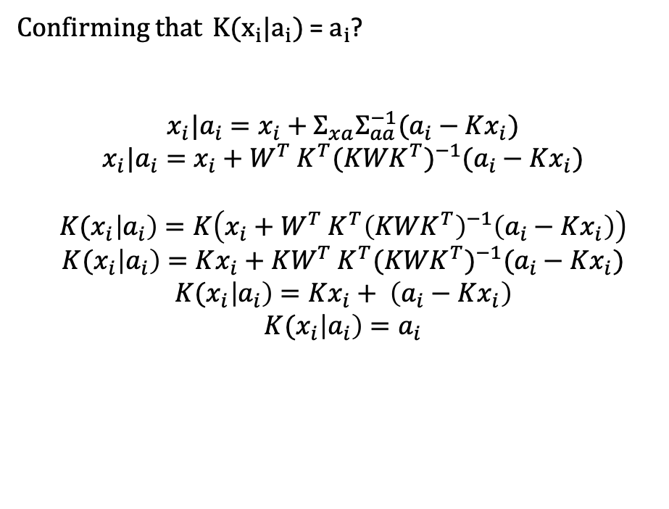
Confirming that ${K(x}_{i}|a_{i})$ = $a_{i}$?
$$x_{i}|a_{i}=x_{i}+Σ_{xa}Σ_{aa}^{−1}(a_{i}−Kx_{i})$$
$$x_{i}|a_{i}=x_{i}{+ W}^{T}K^{T}{(KWK^{T})}^{−1}(a_{i}−Kx_{i})$$
$${K(x}_{i}\left|a_{i}\right)=K\left(x_{i}{+ W}^{T}K^{T}{\left(KWK^{T}\right)}^{−1}\left(a_{i}−Kx_{i}\right)\right)$$
$${K(x}_{i}\left|a_{i}\right)=Kx_{i}{+ KW}^{T}K^{T}{(KWK^{T})}^{−1}(a_{i}−Kx_{i})$$
$${K(x}_{i}\left|a_{i}\right)=Kx_{i}+ \left(a_{i}−Kx_{i}\right)$$
$${K(x}_{i}\left|a_{i}\right)=a_{i}$$

Slide 7
Example;
1D readout
Distribution of data;
2D, mean = (2, 1)
Cov = [[10, 1],[1, .5]]
Decoder
K = (1, 1)
For a given decoder readout (e.g. -10), compute line orthogonal to the decoder (blue), and expected mean (magenta)
E(X | a=-10)
Neuron 2
Readout = -10
Neuron 1

